Slide 1
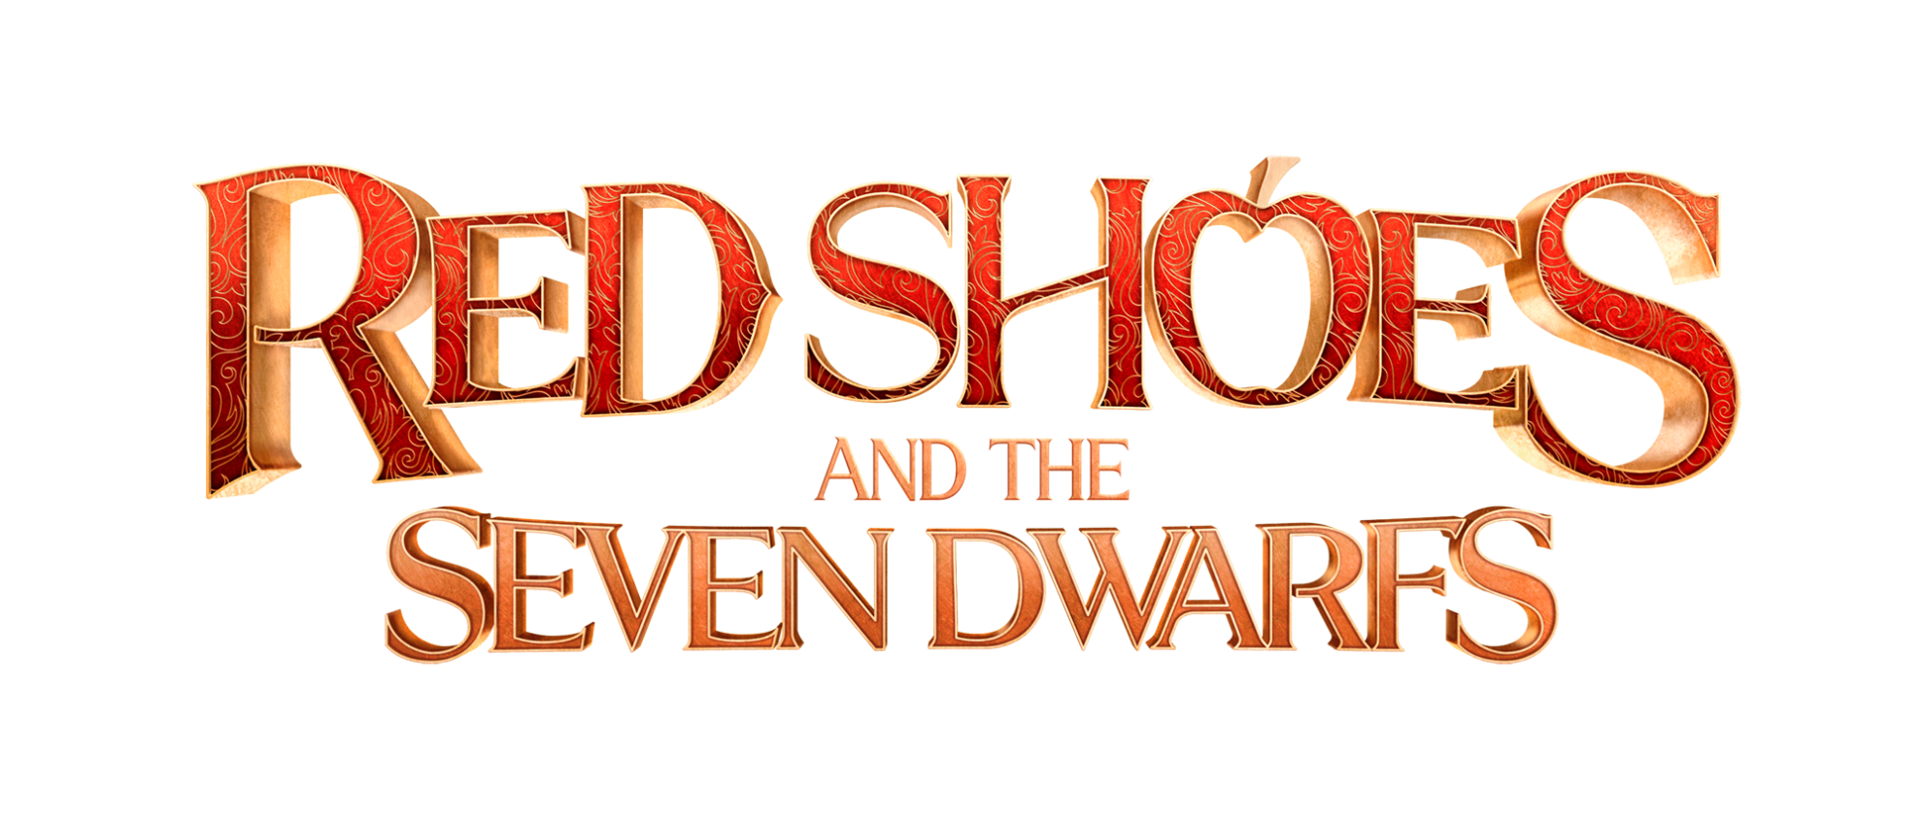

BIBLE
© Copyright Locus Corporation. All rights reserved

Slide 2
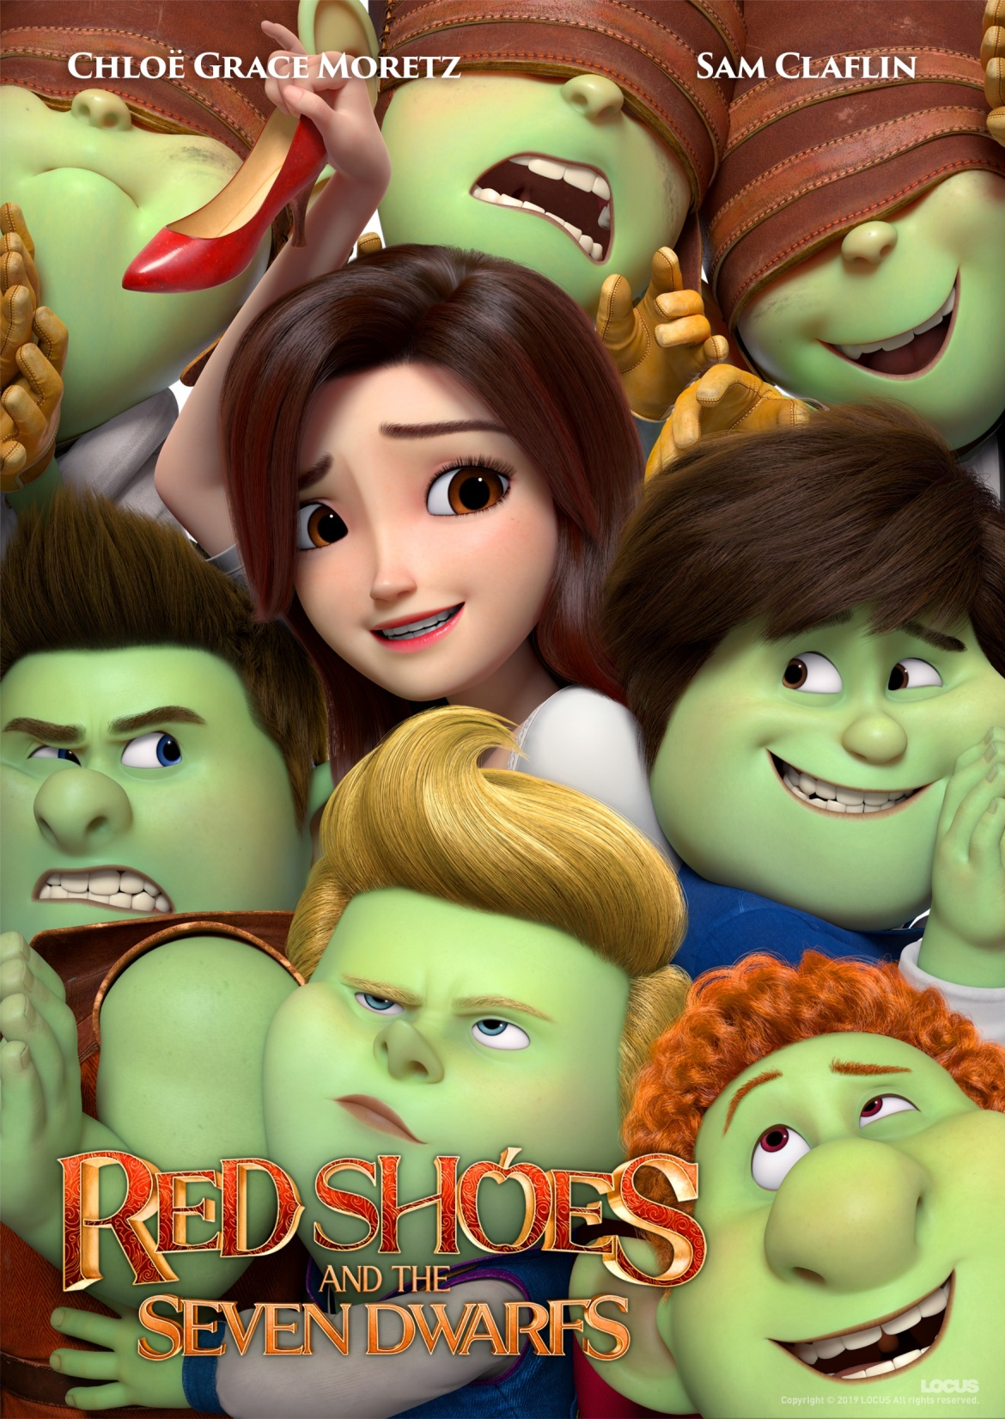
Project Overview
TITLE RED SHOES AND THE SEVEN DWARFS
FORMAT Full 3D CGI Stereoscopic Feature Film
GENRE Family / Adventure / Romantic Comedy
PRODUCTION Locus Animation Studio
RELEASE 2019
DURATION 93 Minutes
MPAA RATING TBD (expects PG)

Slide 3

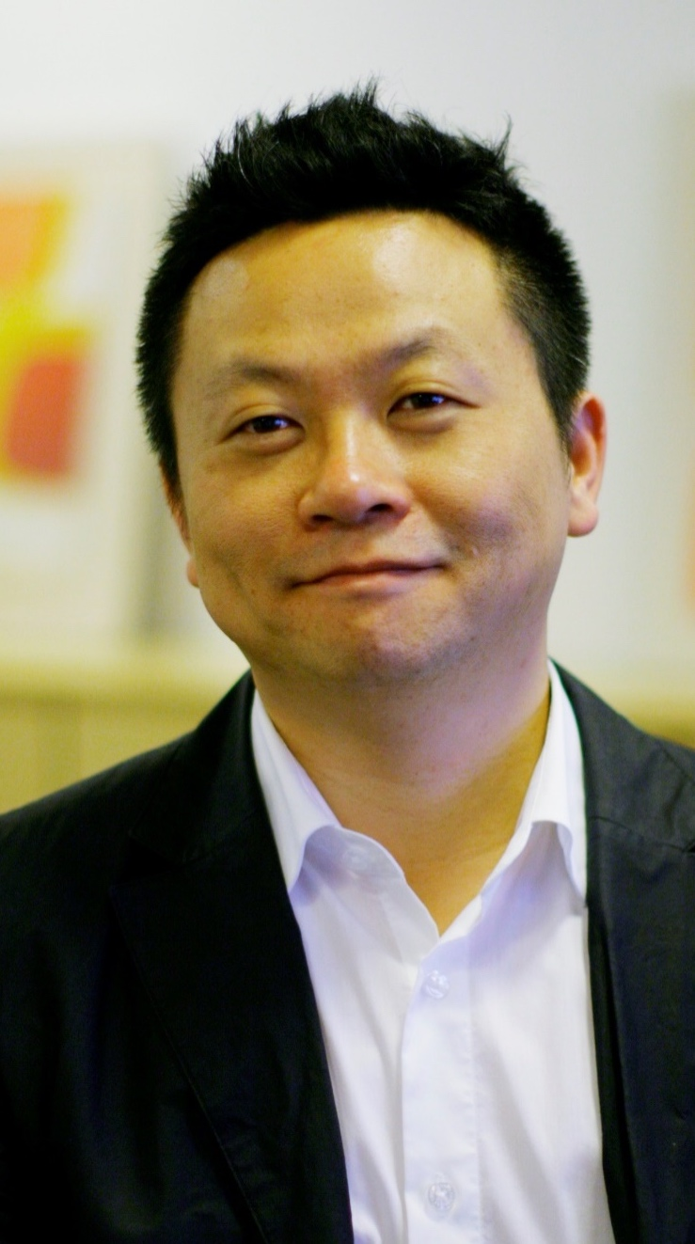
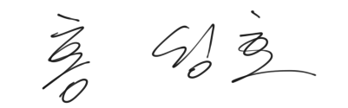
Director’s Statement
If someone were to ask me, “who is the most beautiful person in the world,”
I would say it is the one I love.
For many years, our culture has been obsessed with all things external.
In fact, what someone looks like on the outside has become more important than who they really are on the inside.
I wanted to share a story people may have not known before.
My hope is to carry the truth that there is always more than meets the eye.
Sungho Hong

Slide 4





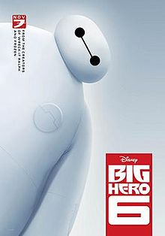
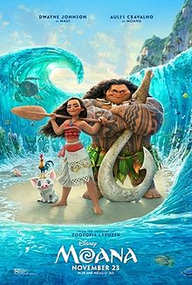
Key Creatives
Jin Kim
Character Design Supervisor/ Animation Director
Jin Kim worked for Walt Disney Animation Studios since 1995 and joined LOCUS in 2016 as the executive creative director. He was the first Korean to work for Walt Disney Animation Studios and contributed numerous credits to many successful franchise of animations.
Filmography
Bolt, 2007
Tangled, 2010
Frozen, 2013
Big Hero, 2014
MOANA, 2016
Animator
Character designer
Character designer
Character design
supervisor
Character designer

Slide 5
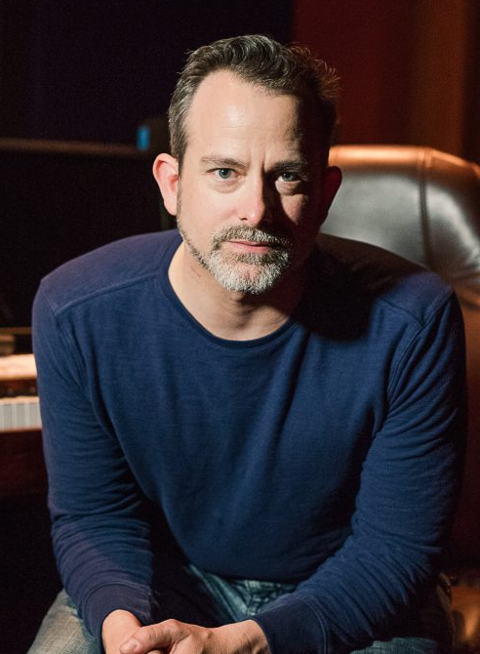
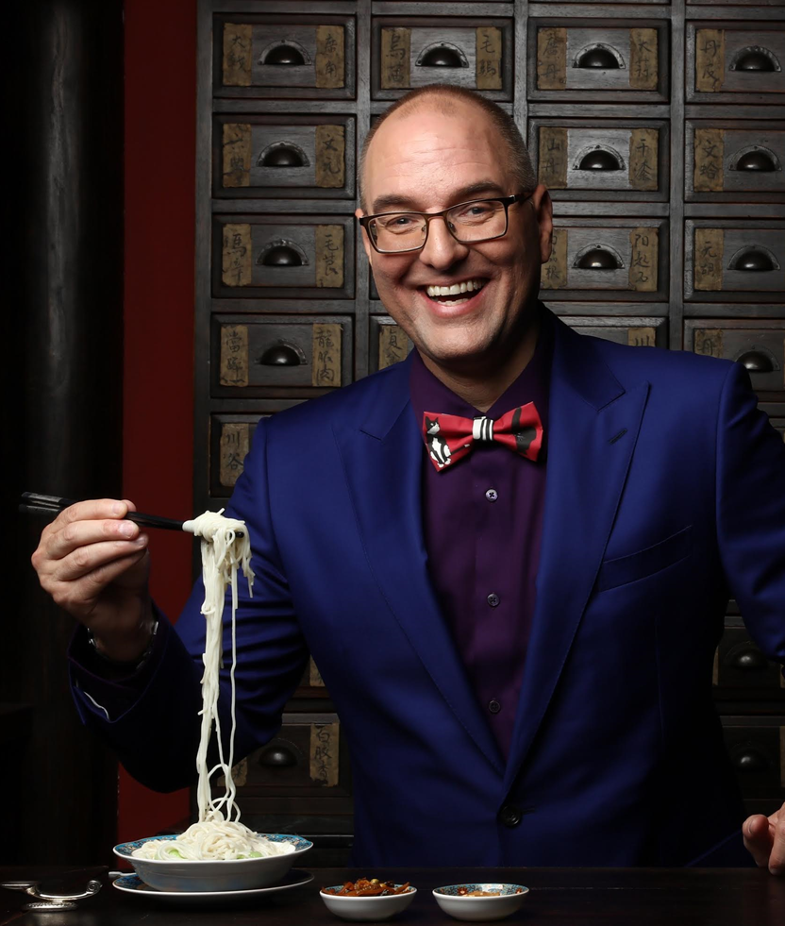



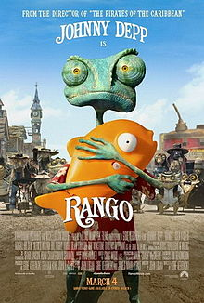


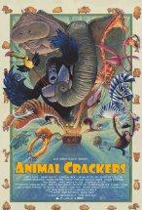
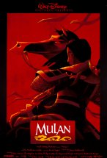

Geoff Zanelli
Tony Bancroft
Music Director
Voice Director
Emmy Award-winning composer
Works with composers Hans Zimmer, John Powell, Harry Gregson-Williams and Steve Jablonsky.
- Scored the fifth installment of Disney's "Pirates of the Caribbean" franchise, "Pirates of the Caribbean: Dead Men Tell No Tales"
Former Director at Disney
Started as the director for Disney’s <Mulan>
Participated in Various Works as Animator Supervisor
Recently Directed Full-length Theater 3D Animation <Animal Cracker> which is scheduled to release soon in the United States

Slide 6

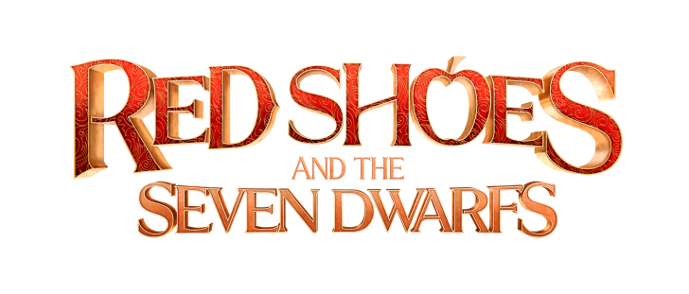
Story Outline
On the Fairytale Island, one out of a dozen people are either a prince or a princess, quite literally. Out of dozens of princes on the island, a special group of princes called the Fearless Seven (F7) are known to be the finest of them all!
As always, 7 princes rescue a beautiful princess from a fiery dragon like a piece of cake, but UH OH they are wrong. The princess is not a beauty like F7 imagines after all! They tease and embarrass the ugly pixie princess and the angry princess curses the princes into a spell that can only be broken with a kiss from the most beautiful girl in the kingdom. However, The fearless group of seven princes, now transformed into the seven Dwarfs, set out on an impossible mission to undo the spell.
Meanwhile, Snow White, whose appearance is far from the perfect beauty that the Dwarfs are searching for, stumbles upon a pair of magical Red Shoes which transforms her into a beautiful girl who she never thought she could be. She escapes from the wicked queen and somehow finds her way into the Dwarfs’ house seeking help to find her missing father.
Can the seven Dwarfs receive a kiss from the most beautiful girl in the kingdom to break the spell AND REVERT TO THEIR TRUE APPEARANCE?

Slide 7
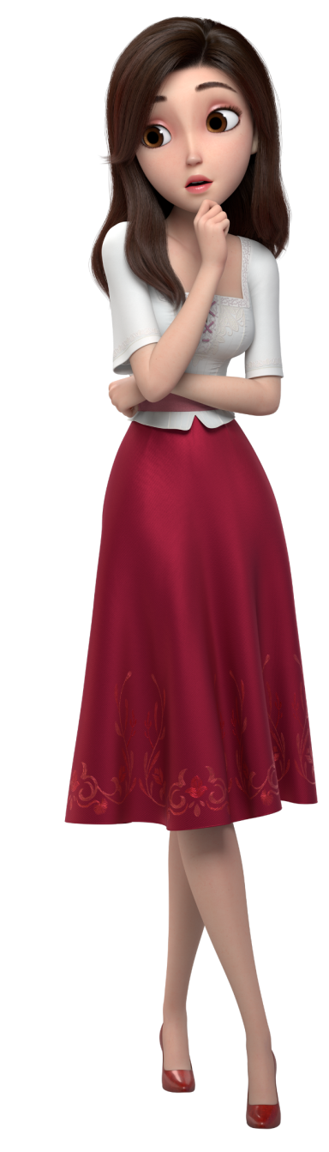
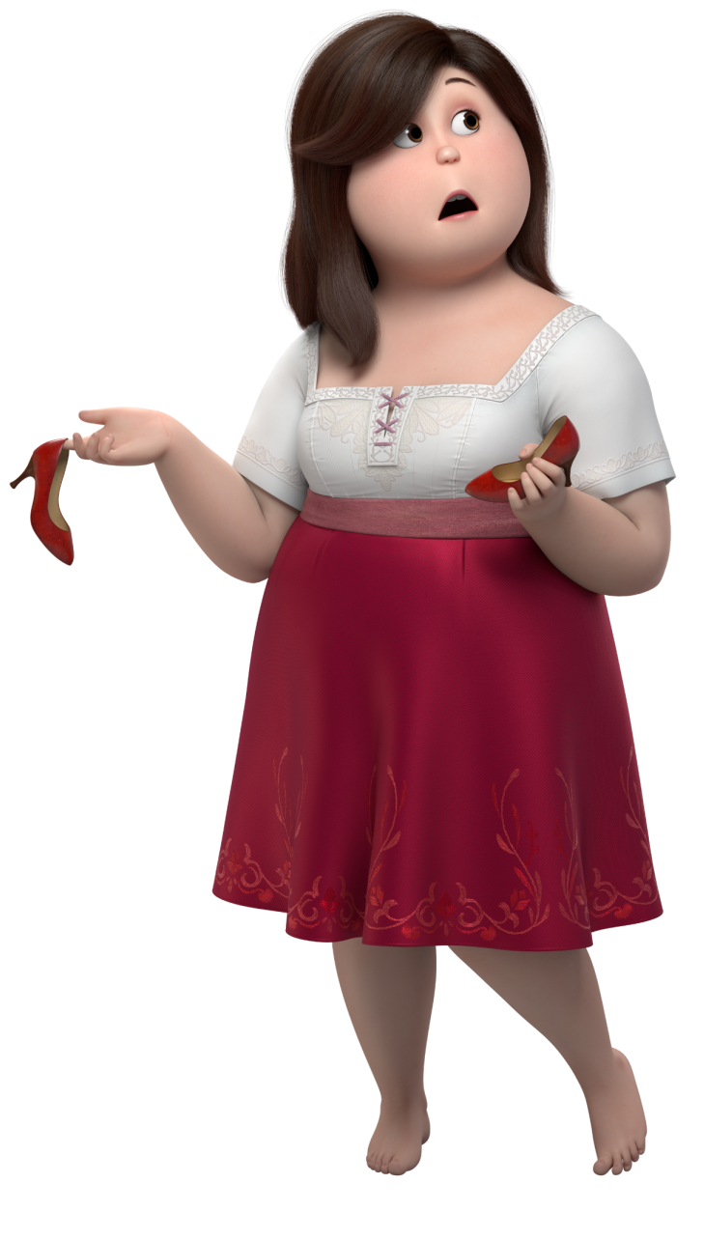
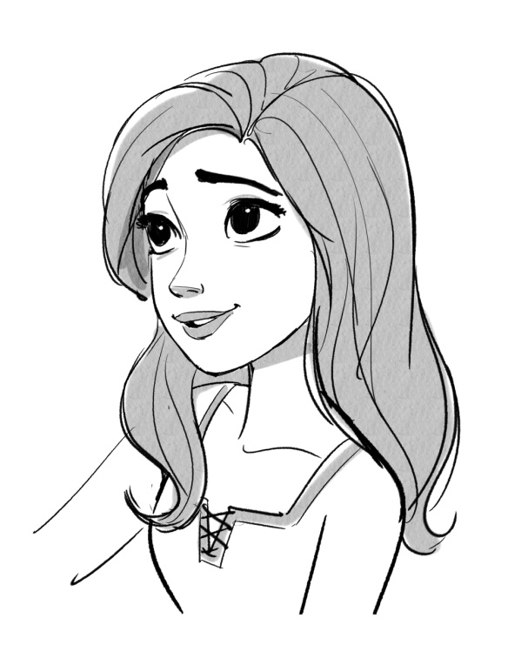
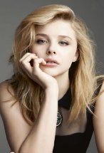





Character Profiles & Voice Castings
Chloe Moretz as Red Shoes & Snow White
A normal girl born into extraordinary circumstances; she’s a Princess who doesn’t fit into the celebrity world of Princesses - or their dress size.
A brave and lively princess with a pure heart. (nickname: Red Shoes)
When she wears the magical red shoes, she becomes the most beautiful and stunning princess in the world.
A female protagonist who makes the main character Merlin and the rest of the Dwarfs realize what real beauty is.

Slide 8
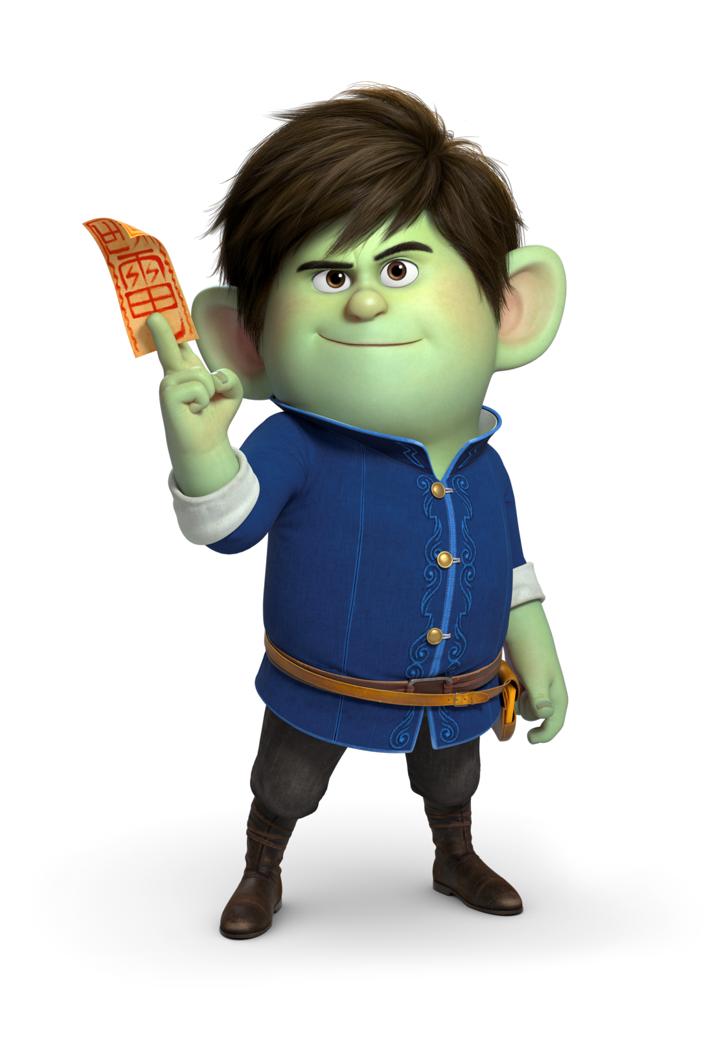
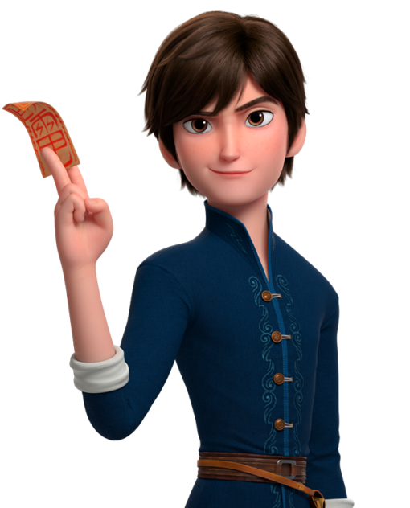
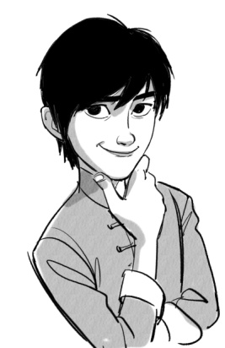
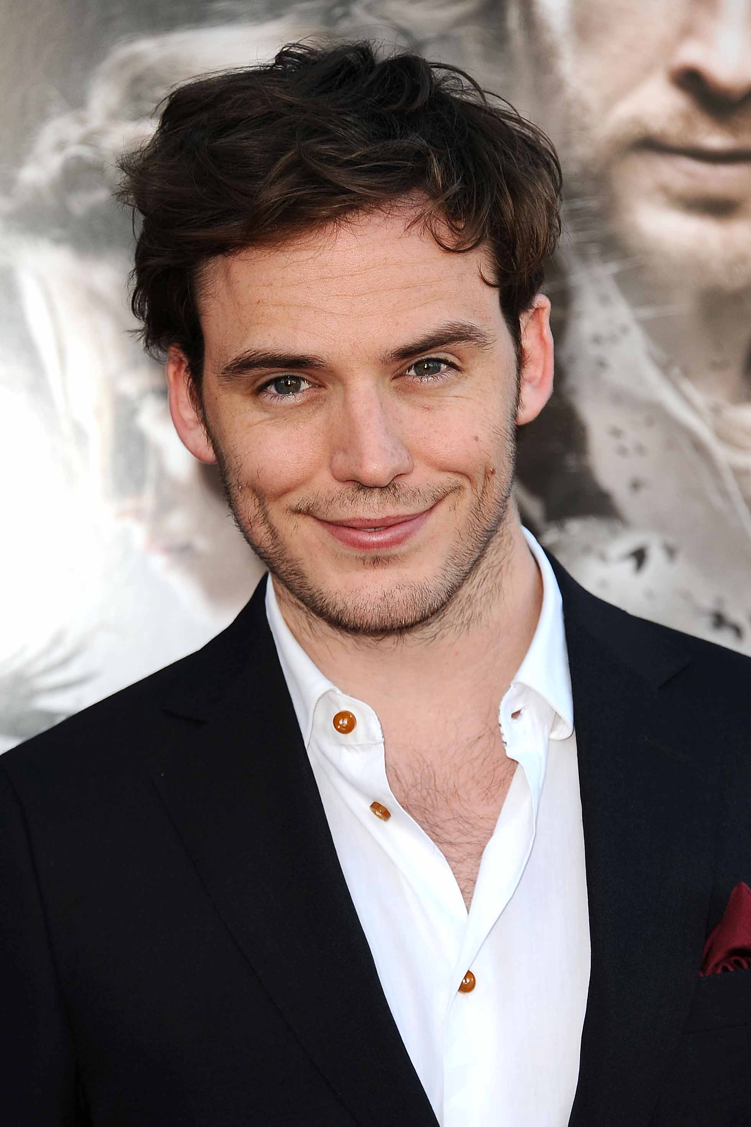





Sam Claflin as Merlin
Prince Merlin, the confident leader of the princess rescue team(F7), is an unfortunate main character who falls under a spell that turns him into a dwarf as he searches for a princess who is a good fit for him.
As he immediately falls in love with Red Shoes at first sight, he is determined to lift his curse.

Slide 9
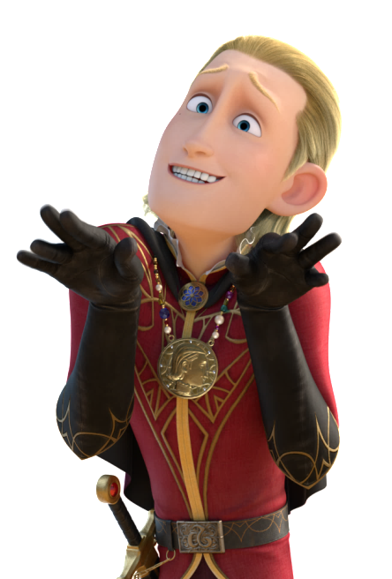
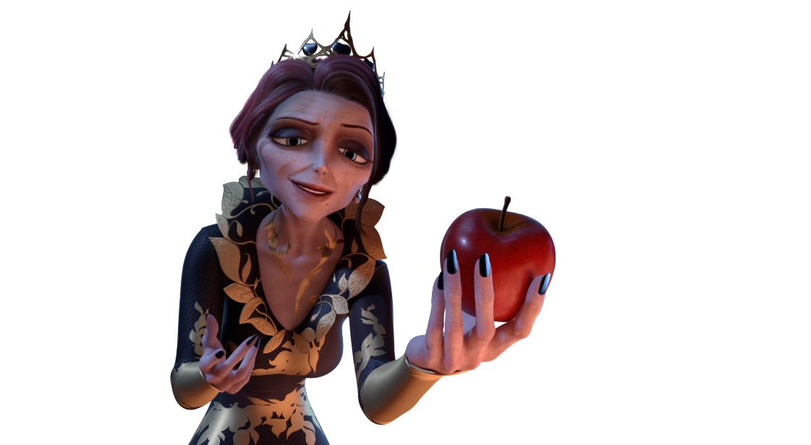
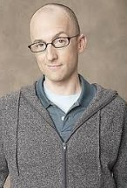
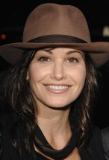
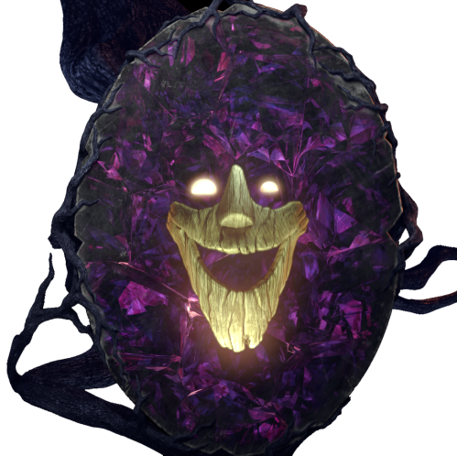
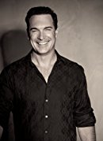













Jim Rash as Prince Average
Gina Gershon as Queen Regina
Patrick Warburton as Magic Mirror
Prince Average enjoys pronouncing his own name elegantly as ‘Av-er-aaaahge’. Although he thinks he has become the new most popular prince among the princesses within the kingdom after F7 disappeared, he remains as a dorky and unpopular prince.
Prince Average negotiates a deal with Regina and chases after the Snow’s crew.
Regina is a witch and Snow’s stepmother and the magical red shoes are her secret method to her permanent beauty.
She casts a spell on the Wood Bear triplets to have them under her control, and persistently chases after Snow to get her red shoes back.
Regina’s magic mirror.
He tells the truth but talks too much.

Slide 10

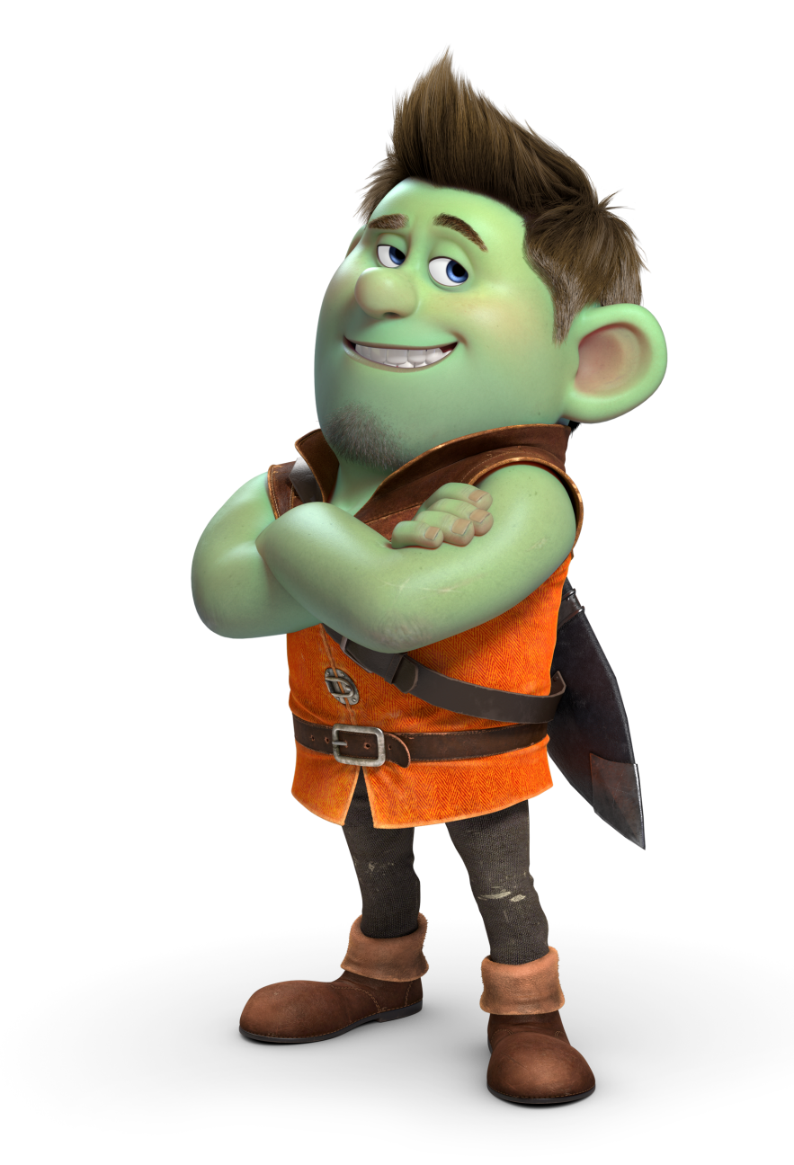


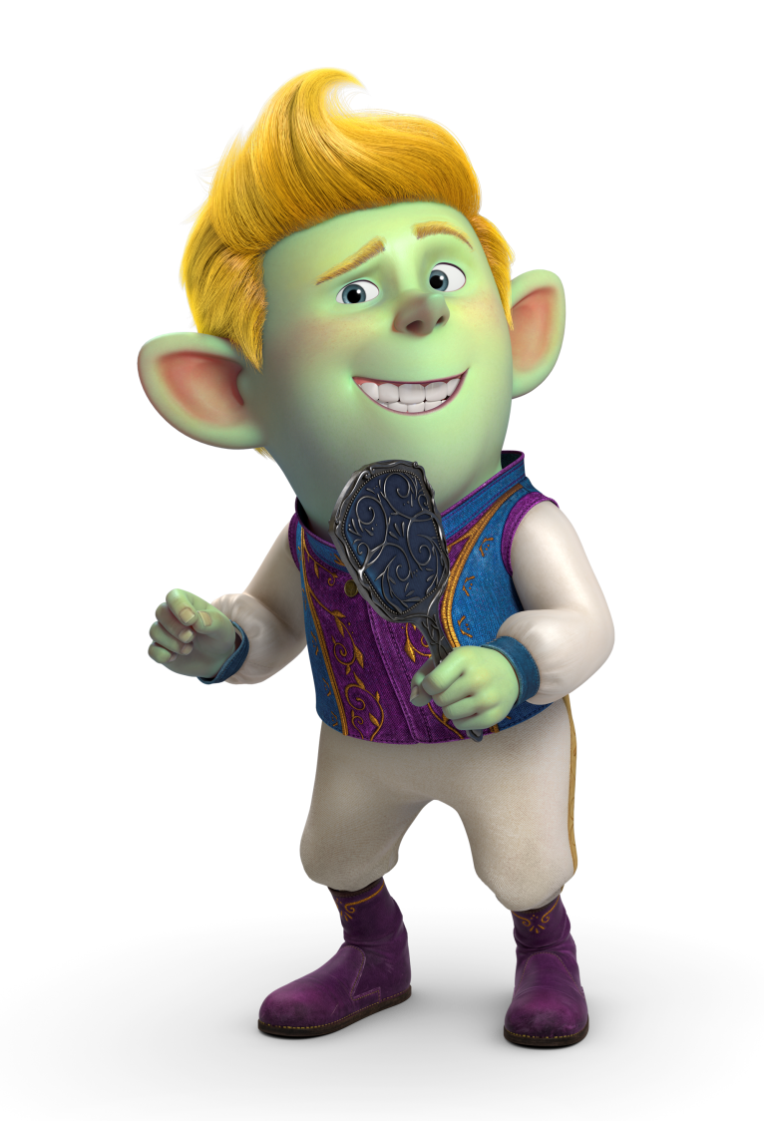
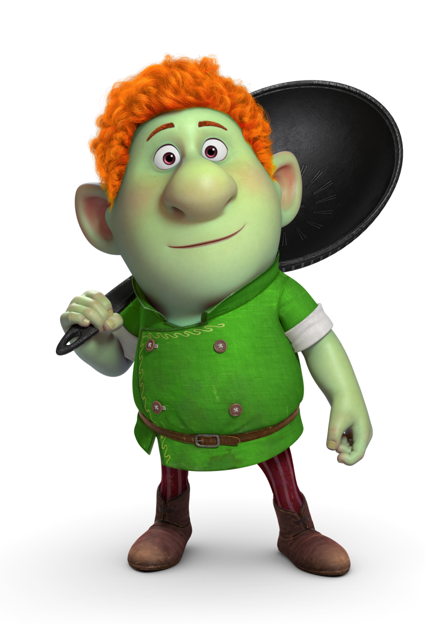



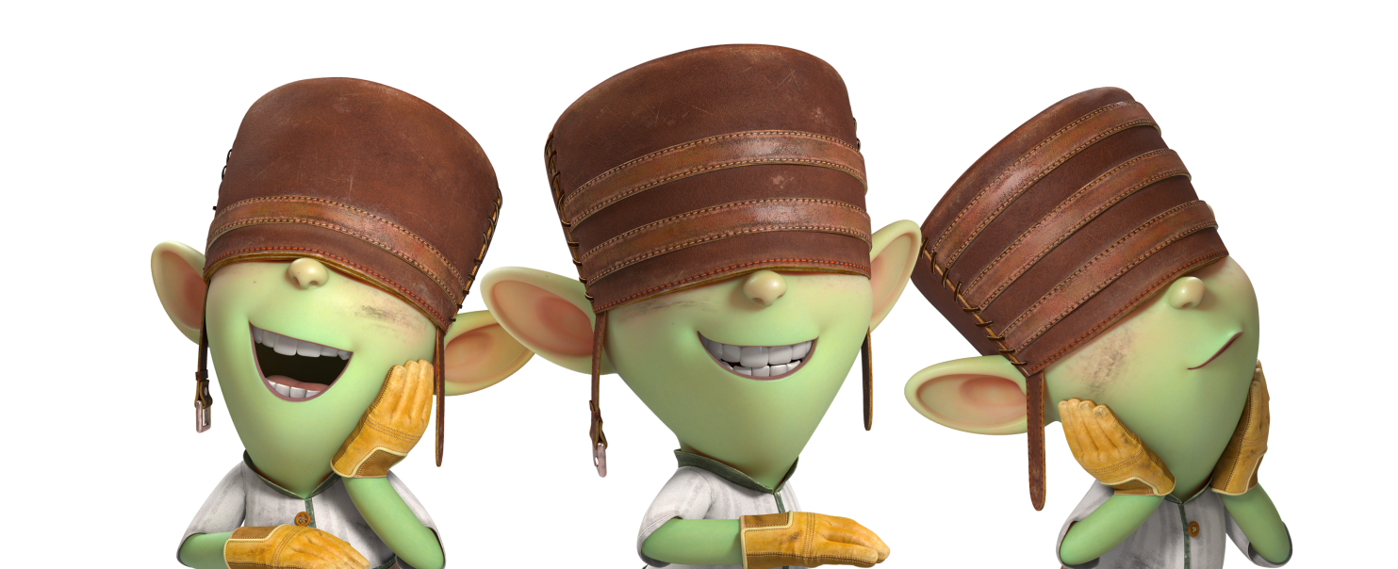
Character Profiles
Members of F7 who used to enjoy their flawless reputation and popularity. Close family-like friends become ambitious competitors as they attempt to lift their curses.
Prince Arthur has a powerful Sword, Excalibur.
Prince Jack is a fashionista and has an invisible cloak.
Prince Hans loves to cook and bake, especially donuts.
Pino, Noki and Kio are the triplets who invent machines and robots that come in handy in the princess rescuing process.

Slide 11
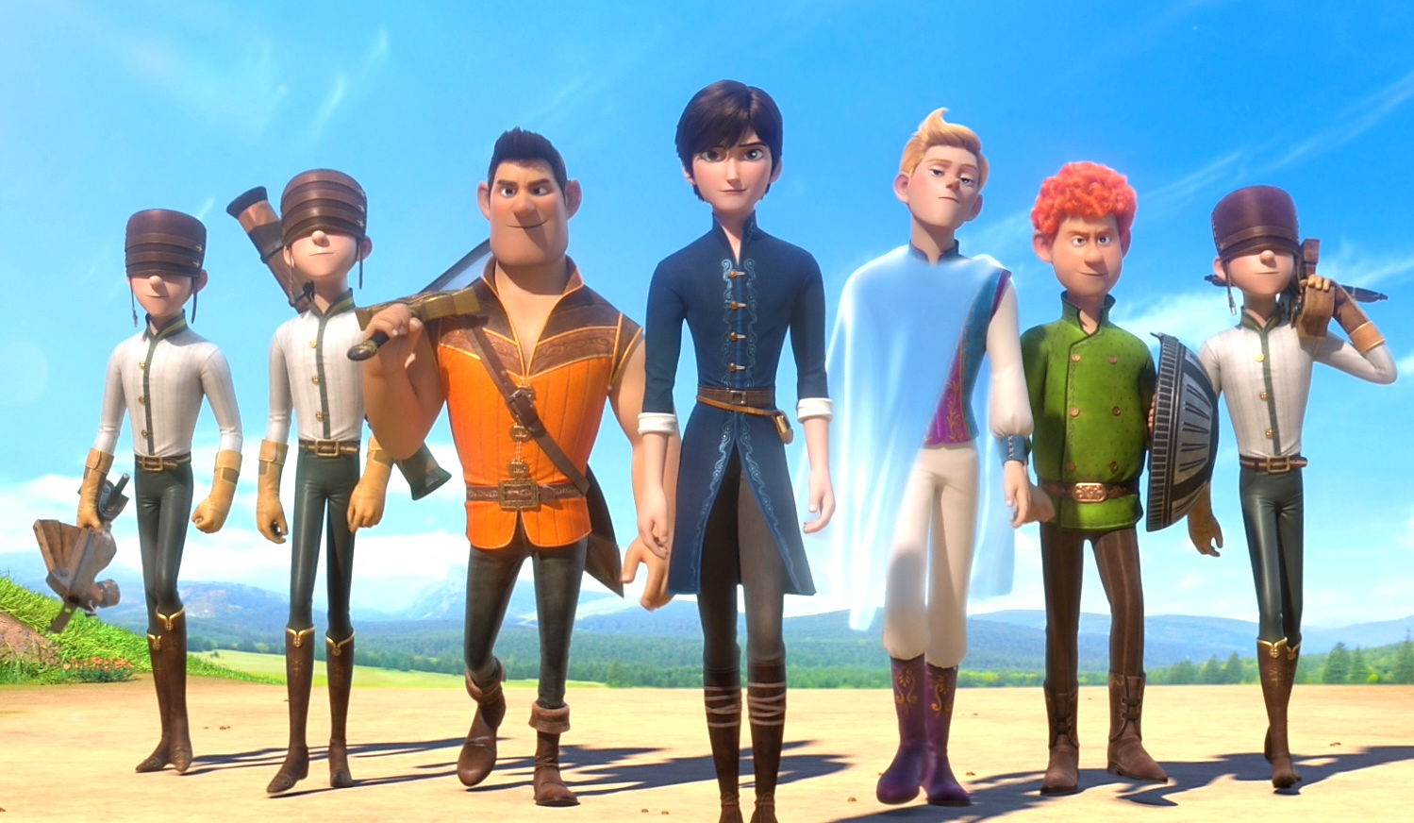
STILLS

Slide 12
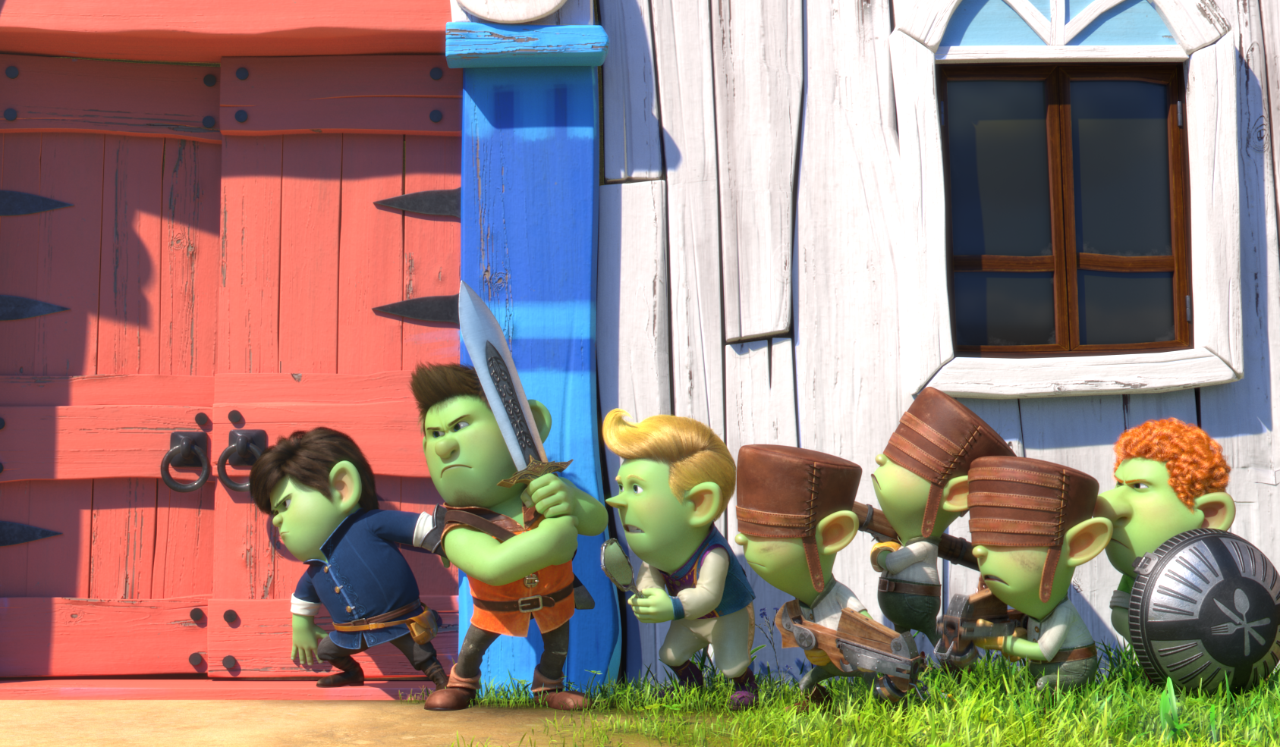

Slide 13
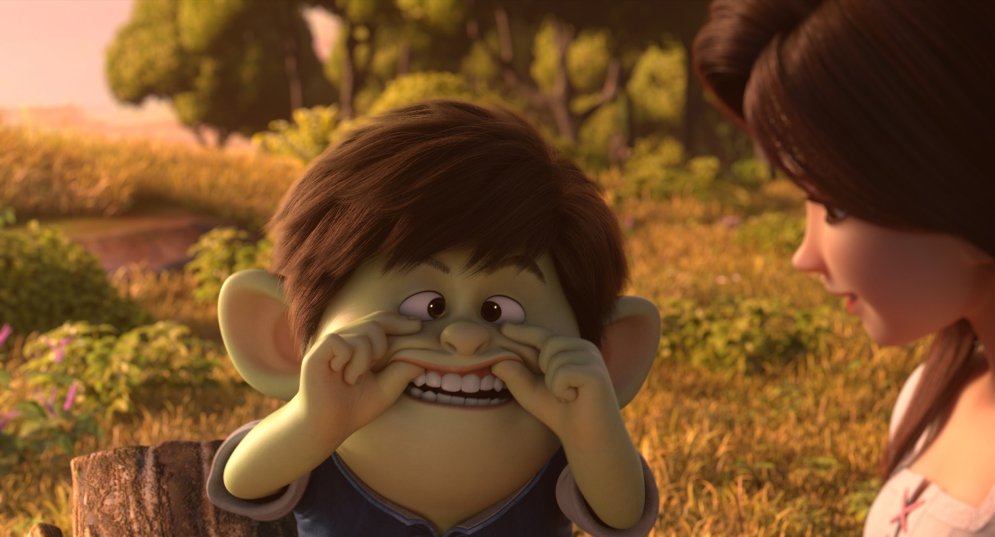
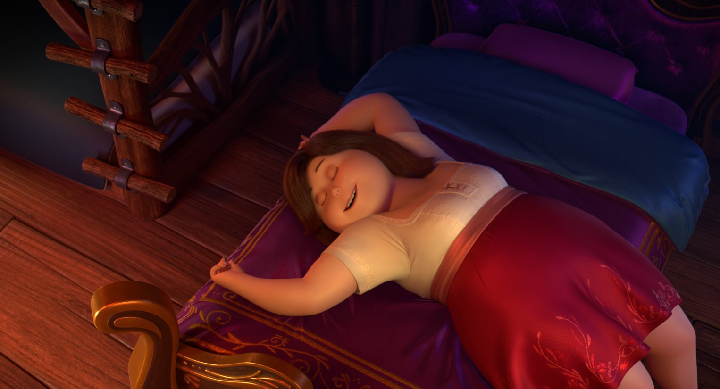
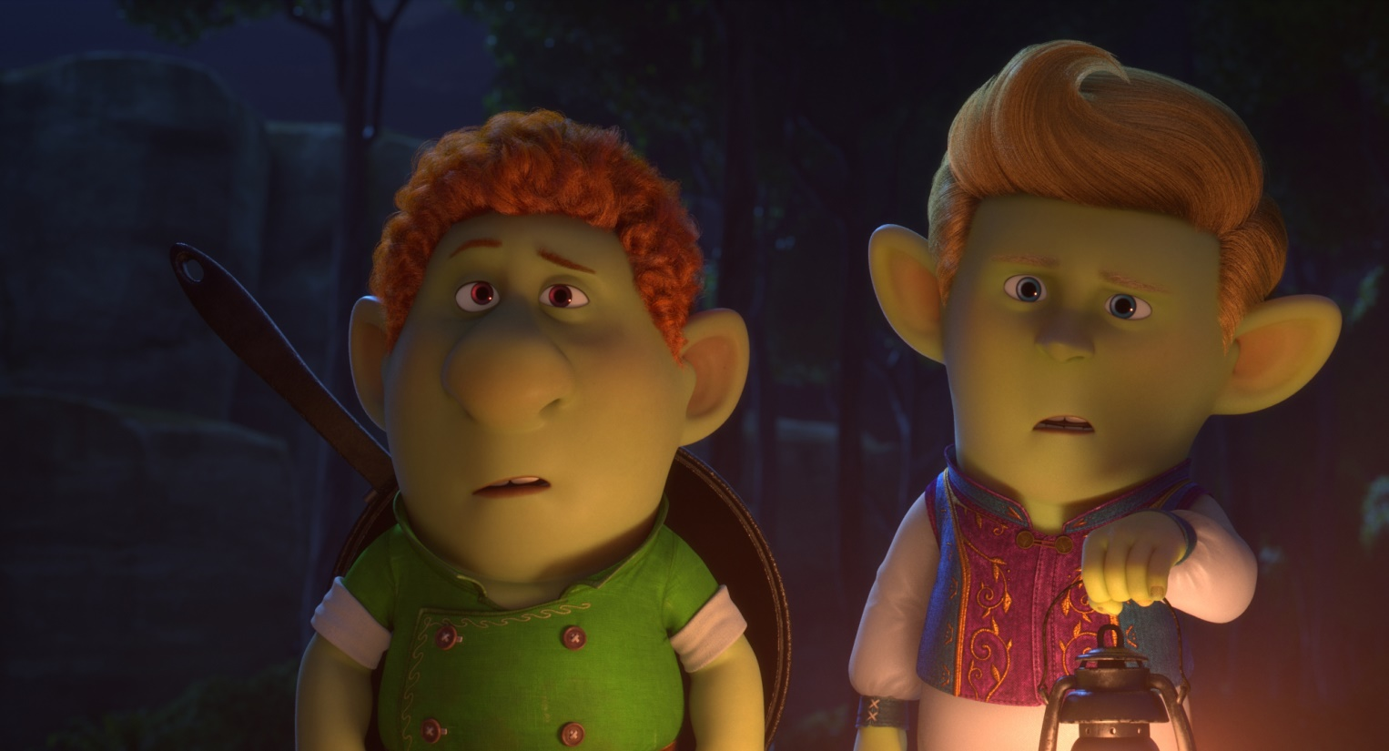
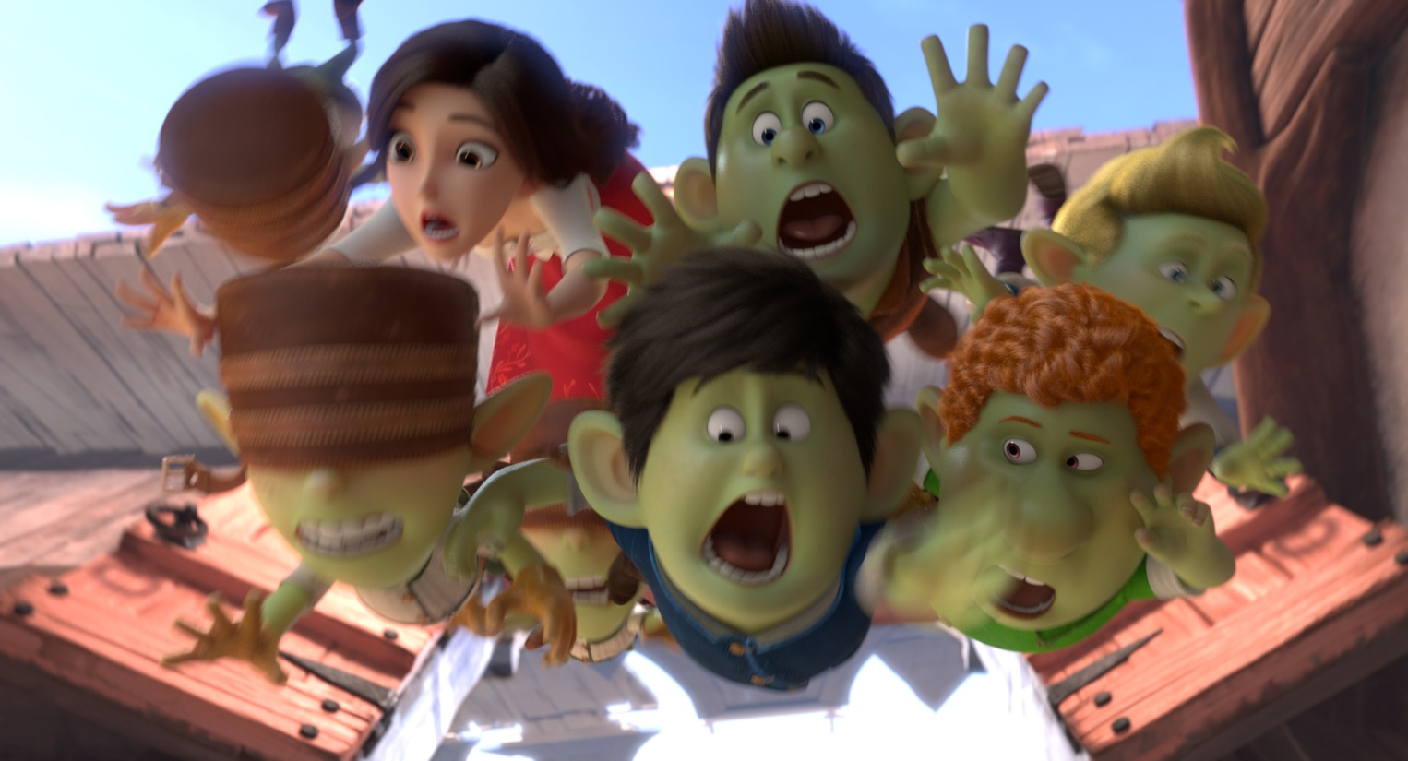

Slide 14
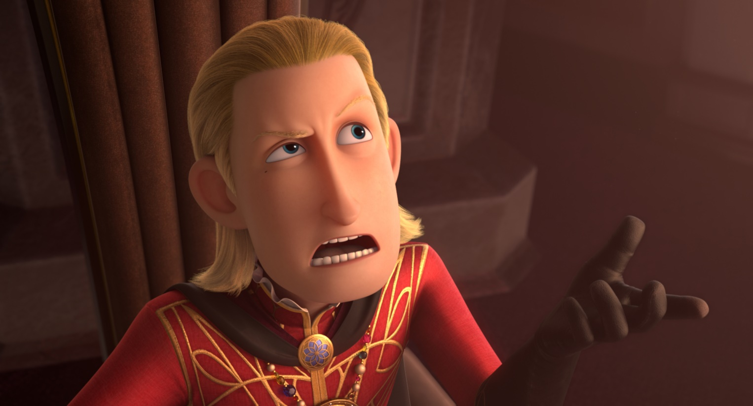
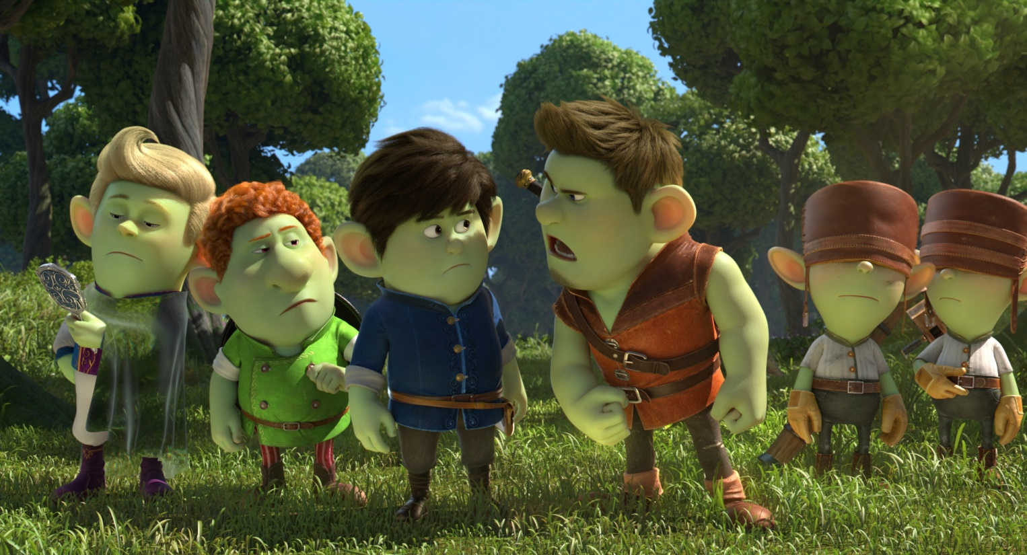
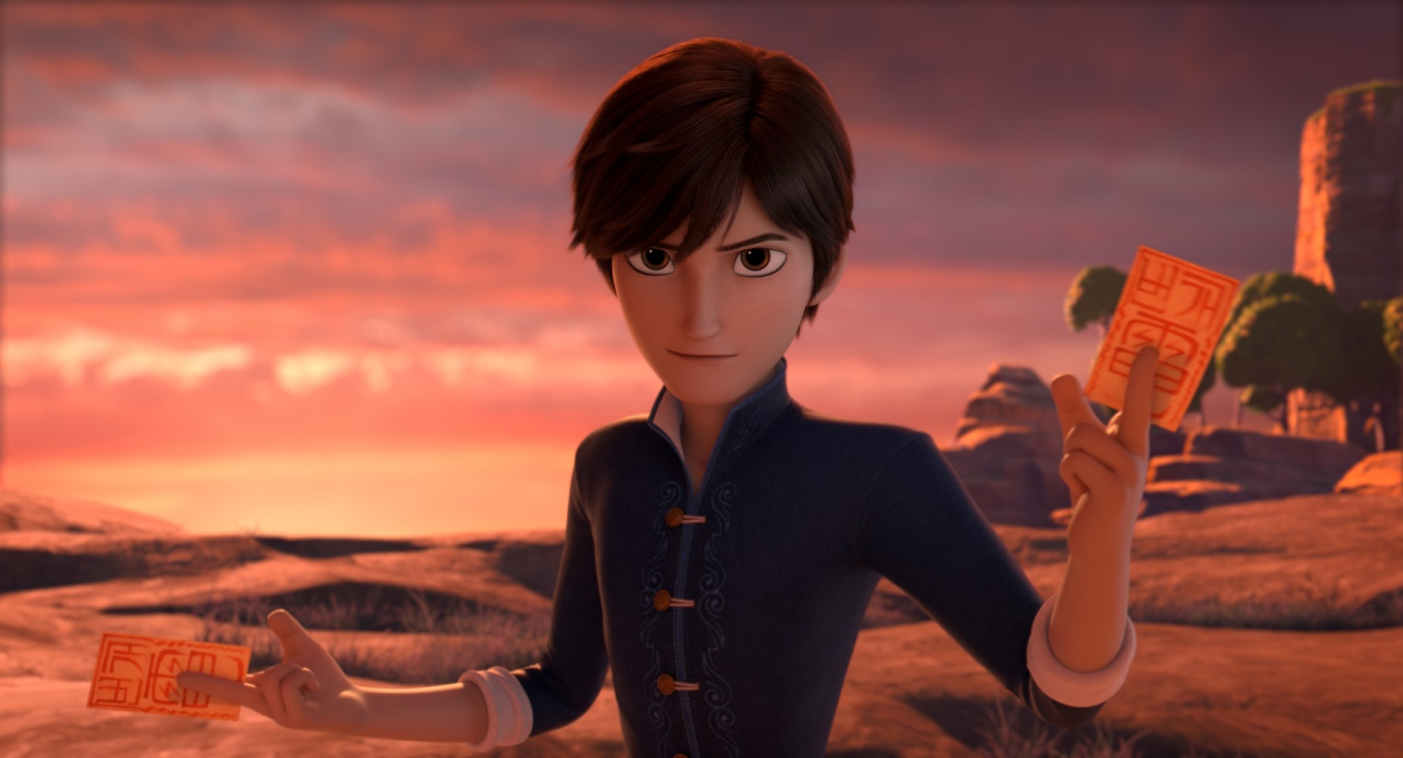
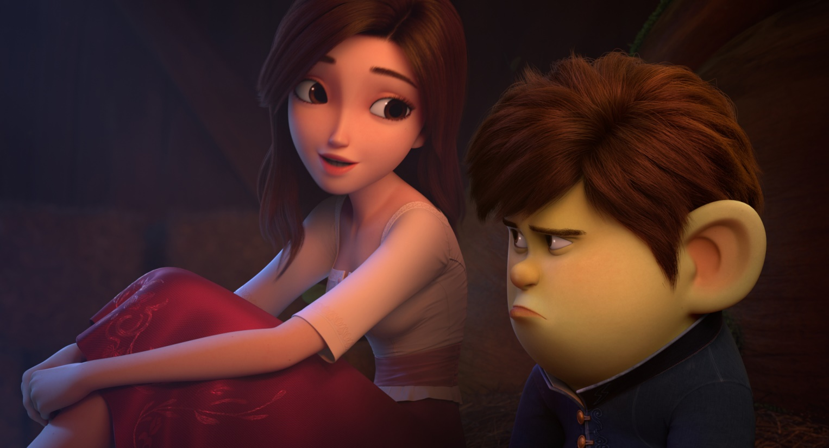

Slide 15
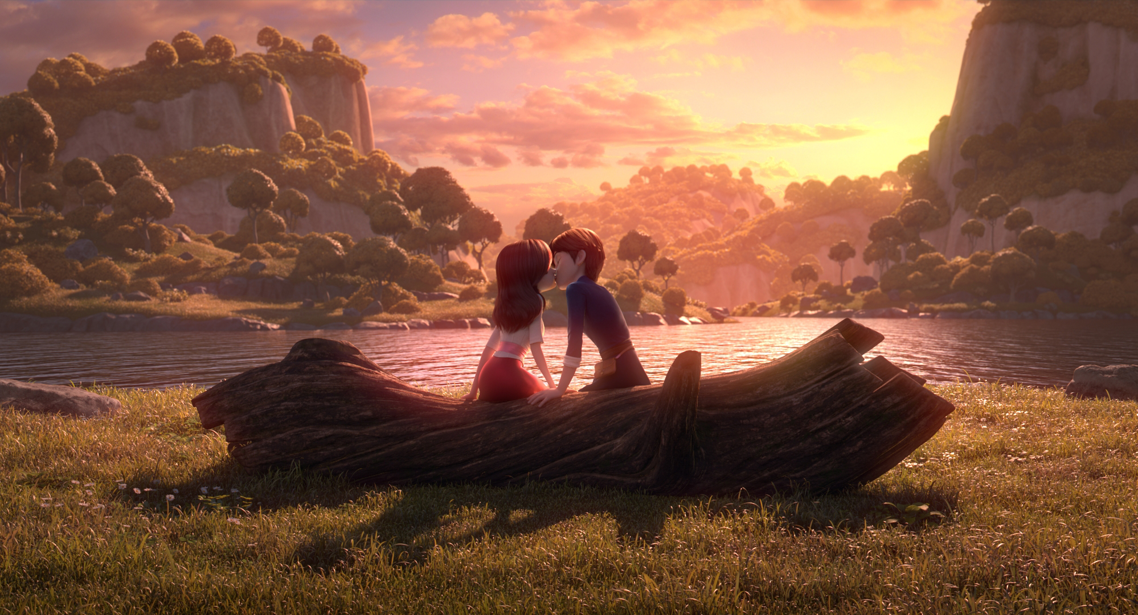
The Adventure begins 2019

Slide 16
The Adventure begins 2019
© Copyright Locus Corporation. All rights reserved

